Slide 1


Gradle and Eclipse IDE as build artifact
Eclipse Converge 2017
Code examples available here
diffplug.com/opensource
Ned Twigg
@nedtwigg
DiffPlug
@diffplug
Notes:
SETUP: lsp4j and swt-chromium

Slide 2
Outline
Gradle vs Maven
Gradle as an adoption vector for Eclipse IDE
IDE-as-build-artifact
Gradle as a contributor vector for Eclipse components (ecj, formatter, etc)
Why is p2 hard in Gradle?
p2 -> Maven
Gradle for Eclipse developers
Maven -> p2
Autogenerate OSGi metadata
PDE build for RCP

Slide 3
Gradle vs Maven
They are both…
Declarative build tools
Convention over configuration
They disagree about the best way to Declare
Maven uses an XML file
Gradle uses a Groovy (or Kotlin) script

Slide 4
Which is most declarative?
A)
B)
C)
[1, 2, 3, 4]
List<Integer> list = new ArrayList<>();
for (int i = 1; i <= 4; ++i) {
list.add(i);
}
range(1, 4)

Slide 5
Which is most declarative?
A)
B)
C)
[1, 2, 3, 4, 5, 6, 7, 8, 9, 10, 11, 12, 13, 14, 15, 16, 17, 18, 19, 20, 21, 22, 23, 24, 25, 26, 27, 28, 29, 30, 31, 32, 33, 34, 35, 36, 37, 38, 39, 40, 41, 42, 43, 44, 45, 46, 47, 48, 49, 50, 51, 52, 53, 54, 55, 56, 57, 58, 59, 60, 61, 62, 63, 69, 65, 66, 67, 68, 69, 70, 71, 72, 73, 74, 75, 76, 77, 78, 79, 80, 81, 82, 83, 84, 85, 86, 87, 88, 89, 90, 91, 92, 93, 94, 95, 96, 97, 98, 99, 100]
List<Integer> list = new ArrayList<>();
for (int i = 1; i <= 100; ++i) {
list.add(i);
}
range(1, 100)

Slide 6
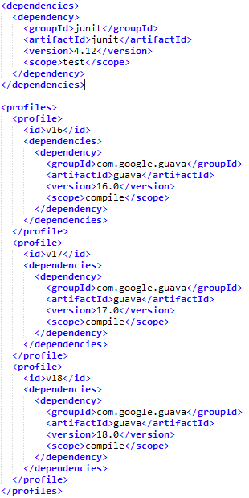
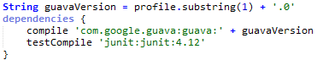
Maven vs Gradle

Slide 7
Gradle vs Maven – automating a new thing
To automate something new in Maven, you can
code in XML
start a new plugin
Gradle has an “automation ramp”
Declare new kinds of task in the build script
Refactor into a project-specific plugin in buildSrc
Refactor into a standalone plugin
New things we automated since our switch
A system for setting up our TeamCity / Artifactory / GitBlit server
A system for distributing VPN credentials
An OSGi-aware obfuscator
Spotless, a format enforcement plugin
Goomph, a bunch of SWT, P2, and RCP build utilities

Slide 8
Outline
Gradle vs Maven
Gradle as an adoption vector for Eclipse IDE
IDE-as-build-artifact
Gradle as an adoption vector for Eclipse components (ecj, formatter, etc)
Why is p2 hard in Gradle?
P2 -> Maven
Gradle for Eclipse developers
Maven -> P2
Autogenerate OSGi metadata
PDE build for RCP

Slide 9
IDE-as-build-artifact
gradlew ide
Advantages of creating the IDE as a build artifact
Easy to onboard contributors.
Don’t worry about messing up the IDE setup, you can always build a fresh one.
Disadvantages
Eclipse JDT and PDE is 200+MB!!!
Or is it…
Bundle-pooling!!!
p2 allows you to install multiple applications which all reference the same pool of OSGi bundles!
Used by Goomph to get PDE efficiently.
Can be used by you to get your IDE efficiently.

Slide 10
IDE-as-build-artifact
apply plugin: 'com.diffplug.gradle.oomph.ide'
oomphIde {
repoEclipseLatest()
pde {
targetplatform {
installation 'target.maven/build'
installation 'target.p2/build/p2asmaven/p2'
}
}
splash 'project_logo.png'
style {
classicTheme()
}
eclipseIni {
vmargs '-Xmx2g'
}
thirdParty {
tmTerminal {}
buildship {}
}
}
SEND PRs!
https://github.com/diffplug/goomph/blob/master/HOW_TO_AUTOMATE_IDE.md

Slide 11
Outline
Gradle vs Maven
Gradle as an adoption vector for Eclipse IDE
IDE-as-build-artifact
Gradle as an adoption vector for Eclipse components (ecj, formatter, etc)
Why is p2 hard in Gradle?
P2 -> Maven
Gradle for Eclipse developers
Maven -> P2
Autogenerate OSGi metadata
PDE build for RCP

Slide 12
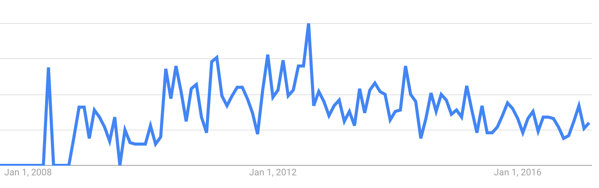
The java build tooling landscape
p2 repository

Slide 13
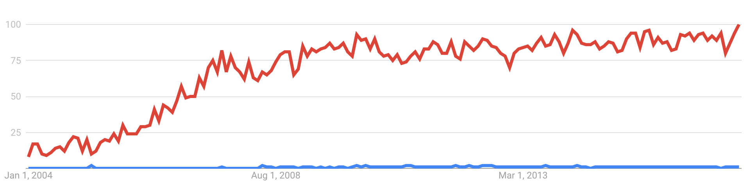
The java build tooling landscape
maven repository
p2 repository

Slide 14
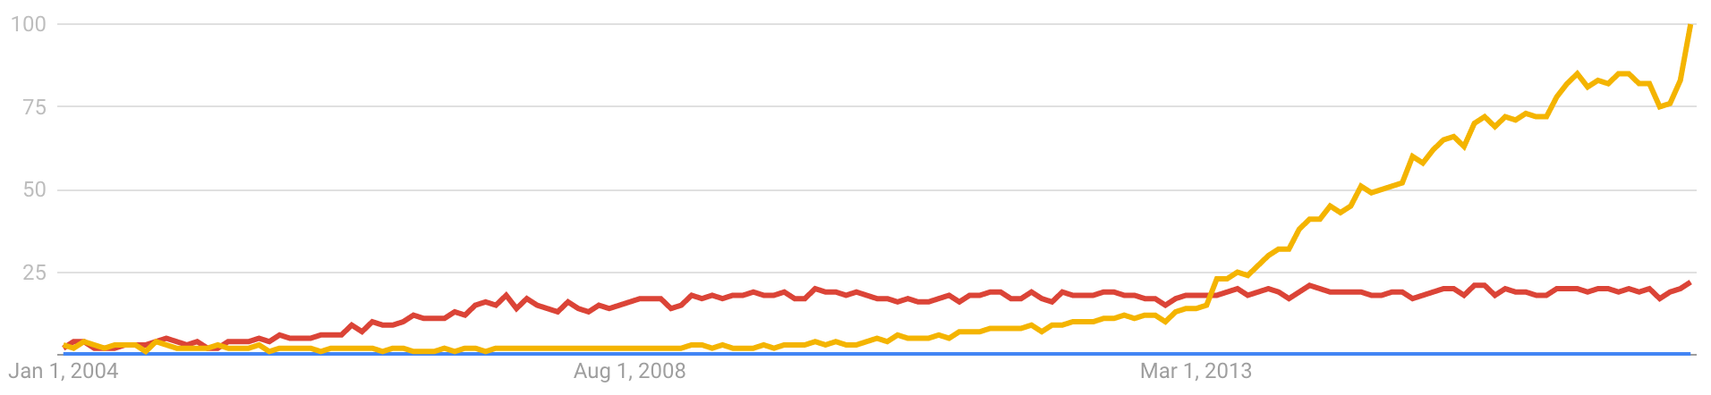
The java build tooling landscape
gradle
maven repository
p2 repository

Slide 15

Consume deps from p2 in gradle
No native support at the moment
David Akehurst’s p2 resolver is close (requires Gradle < 2.8)
He also has a fork of Gradle 2.13 with p2 support
Gradle doesn’t have a public repository API:
https://groups.google.com/forum/#!searchin/gradle-dev/p2/gradle-dev/YQ2-V-RizQg/swXSWeGmqboJ
https://discuss.gradle.org/t/p2-how-do-repositories-work-inside-gradle/19844
Workaround – turn p2 repository into a maven repository
Pioneered by Andrey Hihlovskiy’s Wuff and Unpuzzle.
Captures partial dependency info using Require-Bundle
Simon Templer has a fork which looks at Import-Package and Export-Package

Slide 16



Maven vs p2: Conflict diamonds
Guava

Slide 17
Consume deps from p2 in gradle
Recommended: goomph’s p2.asmaven plugin
Uses the real p2 to download dependencies from update sites (even composite)
Doesn’t encode any dependency information into the maven repo it creates.
// Download from eclipse and put it into maven
apply plugin: 'com.diffplug.gradle.p2.asmaven'
p2AsMaven {
group 'eclipse-deps', {
repoEclipse '4.5.2'
feature 'org.eclipse.equinox.executable'
feature 'org.eclipse.rcp.configuration'
feature 'org.eclipse.platform'
feature 'org.eclipse.platform.source'
}
}
https://github.com/diffplug/goomph

Slide 18
Outline
Gradle vs Maven
Gradle as an adoption vector for Eclipse IDE
IDE-as-build-artifact
Gradle as an adoption vector for Eclipse components (ecj, formatter, etc)
Why is p2 hard in Gradle?
P2 -> Maven
Gradle for Eclipse developers
Maven -> P2
Autogenerate OSGi metadata
PDE build for RCP

Slide 19
Consume deps from maven as target platform
Recommended: Simon Templer’s bnd-platform plugin
Passes all of your dependencies and their transitives to bnd
Automatically wraps them with OSGi metadata
Great defaults, and great DSL for corner-cases
Dumps the result into a folder for easy consumption as a target platform
// Download from eclipse and put it into maven
apply plugin: 'org.standardout.bnd-platform'
platform {
determineImportVersions = true
importVersionStrategy = MAJOR
useBndHashQualifiers = false
bnd(group: 'net.sf.ehcache', name: 'ehcache-core') {
// make hibernate packages optional
optionalImport 'org.hibernate', 'org.hibernate.*'
}
}
https://github.com/stempler/bnd-platform

Slide 20
Create OSGi metadata for your jar
Bnd (by Peter Kriens)
You give bnd your jar and some directives.
It calculates the headers for you.
Lots of gradle plugins that integrate with Bnd
Recommended: goomph’s osgi.bndmanifest plugin
Easy to copy the manifest where the IDE can see it
Automagic merging is disabled by default
apply plugin: 'com.diffplug.gradle.osgi.bndmanifest'
osgiBndManifest {
copyTo 'META-INF/MANIFEST.MF'
}
jar.manifest.attributes(
'-exportcontents': 'com.diffplug.*',
'Import-Package': '*',
)
https://github.com/diffplug/goomph

Slide 21
Create OSGi metadata for your java 9 module
apply plugin: 'java-library'
dependencies {
api 'commons-httpclient:commons-httpclient:3.1'
implementation 'org.apache.commons:commons-lang3:3.5'
}
api {
exports 'com.diffplug.myapi'
}
apply plugin: 'com.diffplug.gradle.osgi.bndautomanifest'
osgiBndManifest {
copyTo 'META-INF/MANIFEST.MF'
}
COMING SOON
(Maybe Q2 2017)
https://github.com/diffplug/goomph/issues/29

Slide 22
PDE Build for RCP
Goomph has p2-director embedded inside it.
Means it can download and install an Eclipse IDE with any set of features (in this case, with PDE Build).
Set these properties to determine which PDE build is downloaded:
GOOMPH_PDE_VER=4.5.2 (for official release)
GOOMPH_PDE_UPDATE_SITE (for snapshot releases)
task buildProduct(type: PdeBuildTask) {
// set the base platform
base(rootProject.file('target.p2/build/p2asmaven/p2runnable/eclipse-deps'))
// configure where the plugins will come from
addPluginPath(rootProject.file('target.maven/build'))
addPluginPath(rootProject.file('target.p2/build/p2asmaven/p2runnable/eclipse-deps'))
// and where they will go
destination(P2_DIR)
// specify that this is a product build
product {
id 'com.diffplug.rcpdemo.product'
version rootProject.version
productPluginDir rootProject.file('com.diffplug.rcpdemo')
productFileWithinPlugin 'rcpdemo.product'
explicitVersionPolicy {
it.resolve('com.google.guava', '17.0.0', '18.0.0').with('17.0.0', '18.0.0')
}
}
}
https://github.com/diffplug/goomph

Slide 23
Eclipse RCP recommended layout
com.diffplug.gradle.osgi.bndmanifest
Generate OSGi manifest
com.diffplug.gradle.eclipse.buildproperties
Uses Eclipse’s build.properties to control gradle build
com.diffplug.gradle.eclipse.excludebuildfolder
Keeps Gradle’s binary artifacts out of Eclipse’s resources search
com.diffplug.gradle.eclipse.projectdeps
Fixes eclipse intraproject dependency problems
com.diffplug.needs17
com.diffplug.needs18
com.diffplug.needsBoth
com.diffplug.rcpdemo
com.diffplug.talks.rxjav…
spotless com.diffplug.gradle.spotless
Formats source code using eclipse formatter.
target.maven org.standardout.bnd-platform
Creates folder containing all Maven deps with OSGi headers
target.p2 com.diffplug.gradle.p2.asmaven
Creates folder containing all deps from p2, and gives Gradle access to the artifacts.
deploy com.diffplug.gradle.pde.PdeBuild
Runs PDE build against plugins from both target folders.
ide com.diffplug.gradle.oomph.ide
Creates an IDE containing this entire project.
https://github.com/diffplug/gradle-and-eclipse-rcp

Slide 24
How to get started
Gradle manual is excellent
https://docs.gradle.org/current/userguide/userguide.html
“Build script basics” is a great starting point
https://docs.gradle.org/current/userguide/tutorial_using_tasks.html
Look at examples
Full RCP application: https://github.com/diffplug/gradle-and-eclipse-rcp
Simple library using deps from p2: https://github.com/diffplug/spotless
Look at goomph
Code and docs: https://github.com/diffplug/goomph
Live chat: https://gitter.im/diffplug/goomph
Follow @nedtwigg on twitter for updates

Slide 25
Evaluate the Sessions
Code examples
Ned Twigg
@nedtwigg
diffplug.com/opensource
Sign in and vote at eclipseconverge.org
-1
0
+1

Slide 26


Gradle and Eclipse IDE as build artifact
Notes:
SETUP: lsp4j and swt-chromium

